Slide 1


Biology in a Box
A science education outreach program brought to you by a partnership
between The University of Tennessee and the National Institute for Mathematical and Biological Synthesis
Visit us on the web at http://biologyinabox.utk.edu
Biology in a Box Team
Program Director/Author/Lead Editor: Dr. Susan E. Riechert (University of Tennessee)
Science Collaborators: Dr. Thomas C. Jones (East Tennessee State University), Dr. Stan Guffey (University of Tennessee)
Mathematics Collaborators/Editors: Dr. Suzanne Lenhart (NIMBioS), Kelly Sturner (NIMBioS), Lu Howard (University of Tennessee)
Outreach Coordinator: Dr. Lynn Champion (University of Tennessee)
Workshop Coordinators: Kathy DeWein (Austin Peay State University), Gale Stanley (Jacksboro Middle School)
Production/Assistant Editor: Kashina Hickson (University of Tennessee)
Previous Contributors: Sarah Duncan, Communications (formerly with NIMBioS), Rachel Leander, Math Collaborator (formerly with NIMBioS)
Resource Editor: Reuben Price
This unit revised February 2017
Copyright 2012 by Biology in a Box, and the University of Tennessee. All materials in this unit and on the Biology in a Box web server (biologyinabox.utk.edu, eeb.bio.utk.edu/biologyinbox) may not be reproduced or stored in a retrieval system without prior written permission of the publisher, and in no case for profit.

Slide 2
Unit 11: Biomechanics

Slide 3
Biomechanics… What does that mean?
When we hear the word “mechanics”, most of us think of cars, engines, and perhaps a lot of grease. Back in the time of the Greeks, however, the term mekhane, which is where we get the English word “machine” from, more often referred to tools than just machines (since the ancient Greeks didn’t really drive around in cars!).
Mechanics really talks about using tools to take advantage of forces and physics to move objects and accomplish tasks. In science we use mechanics to help us understand the motion of objects which can teach us about the physical world around us (which is where the “bio” part of biomechanics comes in!).
In this unit we will be learning about a number of different principles where physical laws interact with the biological world in what we call Biomechanics.

Slide 4
Contents:
Section 1: Biomimetic
Section 2: From Skeletons to Bridges
Section 3: Jaws as Levers
Section 4: Projectile Motion: Drop, Squirt, and Throw!
Section 5: Similar Things to Wings: Understanding Drag
Section 6: Bioacoustics

Slide 5
Section 1: Biomimetic
Bio – refers to life.
Mimicry – means to imitate
Many times in the world of mechanics, engineers will look to nature to gain inspiration and new ideas on how to solve problems.
  We can take designs from nature and use them in designing products and devices through engineering.

Slide 6
Example: Gecko Toes
The toes of Geckos have inspired technology for different types of reusable adhesives and have helped us to develop better tires for our vehicles.

Slide 7
Biomimetics challenge!
Take a look at the picture collage in the workbook and try to match the proper technological product with the corresponding biological “blueprint”!
Check your answers under Exercise 1 for the Biomimetics Unit.

Slide 8
Section 2: From Skeletons to Bridges
Many animals besides humans are accomplished builders. Animals have had a great deal of impact on their surrounding habitats and their efforts have helped to shape the world around them.
Humans have long been fascinated by the structures that various animals have made, such as termite mounds, bird “apartment” nests, honeycombs, spider webs and many others. We are so inspired by these structures that we have used them to create structures of our own using the same designs.

Slide 9
Exercise 2a: Spaghetti Spans Bridge Building
When we drive around from place to place, we often travel over bridges and 1 in 9 of the bridges we cross have been deemed to be in “bad shape”. Most of these are bad from being so old, but design can sometimes be a problem too.
In this exercise you learn more about the important factors of bridge strength.
Each group will develop a bridge design plan using K’Nex building pieces and will then construct that bridge using dry spaghetti noodles that has to cross a 10 inch span between two desks.
Once all bridges are built you will determine whose bridge is the strongest based on how much weight it can hold!
  Refer to the Workbook for specifics!

Slide 10
Exercise 2b: Under Stress!
Our bones, and many other things, work very similarly to bridges in the way that we handle stress from forces like gravity.
There are 3 main types of stress: Tension, Compression, and Bending
Tension is when forces pull on an object from opposite sides
Compression is when forces push on an object from opposite sides
Bending is when force is applied at a right angle to a certain object
In this exercise your teacher will have several volunteers come up and manipulate some pencils to further understand the 3 types of stress.

Slide 11
Exercise 2c: Bridge Competition take 2!
Now that we know a little bit more about the 3 types of stresses: Tension, Compression, and Bending; we are going to see if we can apply that knowledge to produce a stronger bridge!
Civil engineers use the principles all the time to create what we call Truss Bridges, which were developed by looking at nature for a blueprint like we discussed in Unit 1. These bridges are very simple in design but they are very sturdy.
A Truss is built in such a way that each member of the unit distributes the weight of the load to reduce bending stress. This most commonly comes in the form of triangles that form an arch.

Slide 12
Bridge Competiton take 2
Quadrupeds such as apes and humans have a similar arch in their spine that helps to relieve the stresses of tension and bending.
In the second trial of our Bridge Building experiment, each group will have the opportunity to build a new bridge that mimics the design that we have seen in Truss Bridges and Quadrupeds.
Use the web to observe the structure of many skeletons to see the way that the hips and backbone support weight.
Once you have completed your research, use the same design as Exercise 2a to create and test your bridges!

Slide 13
Section 3: Jaws as Levers
You may not have thought of it before, but we use levers everyday. Our jaws, and any set of jaws that creatures have, are a great example of a lever.
A lever is commonly known as a simple machine that is used to move heavy objects or gain a mechanical advantage in applying force to an object (like chewing food).
There are 3 types of levers, called classes, that differ in the positioning of the fulcrum, load, and effort elements.
In this unit we will be exploring the usefulness of Class 1 levers in nature by working through a series of exercises.

Slide 14
Exercise 3a: The Lever: a simple machine
Levers usually consist of a solid beam that can rotate on a support called the fulcrum
Power is known as the rate of doing work, and is measured by multiplying the force applied to an object by the velocity of that object.
The Law of the Lever is a ratio used to describe the relationship between force applied and the subsequent force output based on the length of the lever.
In the following exercises you will physically explore how changing the position of the fulcrum affects the mechanical advantage of the lever.
  Refer to the workbook for specifics and for formulas.

Slide 15
Exercise 3b: The vertebrate jaw
The development of jaws in early fish is considered as one of the greatest advances in vertebrate history.
Jaws appear to have formed from the front-most gill arches in fish and consist of upper and lower structures that are used to grasp or manipulate food.
This structure is very similar to the class 1 lever that we commonly use, a pair of pliers.
In this exercise we will be looking at different sizes and shapes of pliers to explore the relationship between jaw shape and dietary preference in fish and birds.

Slide 16
Section 4: Projectile Motion
Projectile motion is a physical principle that assumes that once and object is dropped or thrown (projected) it will continue in motion until it is influenced by the pull of gravity.
Many organisms operate under the principles of projectile motion to drop from trees to escape predators, jump as a form of movement, or throw objects.
In this unit we will perform exercises to help us further understand the horizontal and vertical aspects of projectile motion and how organisms operate under these principles.

Slide 17
Exercise 4a: Free Fallin’!
As we previously mentioned, creatures can fall from objects for many reasons, may to escape a predator, chase a competitor, look for a mate, or search for food.
In this exercise we will explore the parameters of how long it will take an animal to reach the ground after falling from a branch, ledge or other source for any number of reasons.

Slide 18
Exercise 4b: launching
In exercise 4a we learned about projectile motion in terms of falling or being thrown in simply the vertical direction.
There is a second form of projectile motion that includes the not only the vertical component, but also the horizontal component. This type of motion is also influenced by the angle at which the object is thrown.
Many organisms across the planet operate under the principles of projection for various reasons. Spitting cobras shoot a stream of venom to deter potential predators while some monkeys will throw food or poop for the same purpose!
Whatever the reason may be, these actions follow the rules of projectile motion in the horizontal and vertical planes.
In this exercise we will examine the parameters of launching by using rockets to understand how launching differs from free fall.

Slide 19
Exercise 4c: Stop the monkey’s escape!
For this exercise you will be forced to think outside of the box a little bit. Imagine you are a zookeeper and one of your monkeys has escaped. The monkey is hanging from a tree limb and is about to drop to freedom. Your job is to use a tranquilizer dart to capture the monkey before he escapes, but you only have one shot!
Using this principles that you have learned, and the formulas that are provided in the workbook, you have to determine where to aim so that you hit the monkey in the middle of its free fall.
In the exercise you will use the straw rocket launcher from before to simulate the tranquilizer gun and capture the “monkey” before he escapes!

Slide 20
Section 5: Similar things to wings: drag
In all living organisms, an important part of life is dispersal: moving away from parents or a cluster of competing individuals in order to find food or mates.
Dispersal can have a positive effect on the genetic structure of a population as it helps to bring in new characteristics to a certain group.
Dispersal can lead to a species occupying a new habitat which helps them to more easily survive environmental changes.
All organisms disperse, but not all species do so in the same way.

Slide 21
Section 5: Similar things to wings: drag
While animals are generally capable of moving themselves around to disperse, plants cannot disperse quite so simply, so they rely on 3 main mechanisms to disperse:
  Free Fall/Gravity dispersal: This is achieved by a heavy fruit or seed falling from its parent plant (think of an apple falling from a tree and rolling away from its parent tree).
  Launch dispersal: This type of dispersal occurs by the parent plant launching its seeds out by some mechanism (a type of flower called the impatiens fling out it seeds when it is touched by a passing animal).
  Drag/Wind dispersal: Many types of plants, like the dandelion or maple tree, produce tuft-like fruits or seeds that help them float away when the wind blows.
In this unit we will further explore the effect of drag and the ways that it influences dispersal in plants, through a series of exercises.

Slide 22
Exercise 5a: Forces and falling objects
In exercise 4a we examined the principle of free fall under which all objects drop at the same acceleration. In this set of exercises we will look at the effects of air resistance (drag) on movement of seeds in flight and the way it limits the velocity of falling objects.
For this set of experiments we will be dropping a series of different objects in different forms to see how the principle of drag changes the way that objects fall to the ground.

Slide 23
Exercise 5b:Exploring Dispersal in nature
Our next exercise will look at how dispersal applies in biological context by experiments with maple seeds, also called samaras, and by looking at gliding mammals.
This type of dispersal is acted upon by the free fall parameters as well as drag. These experiments will help us to understand how the physical principles interact with biological organisms to result in dispersal parameter for organisms.

Slide 24
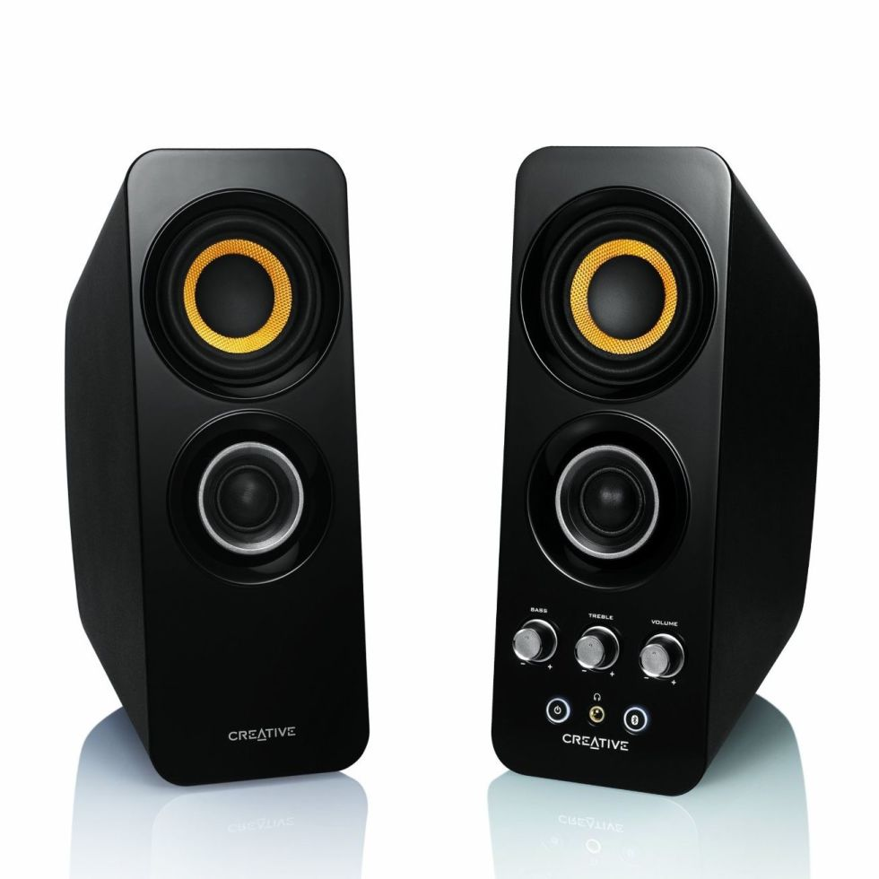
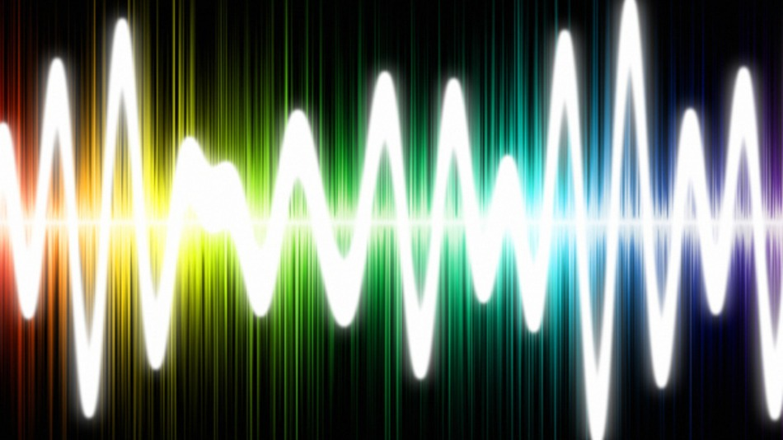
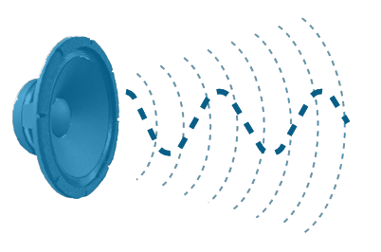
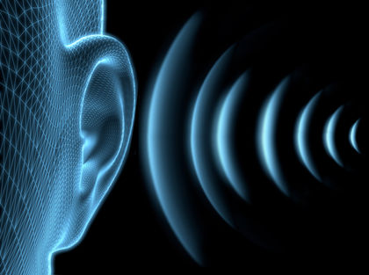
Section 6: Bioacoustics
Acoustics is an interdisciplinary science that studies the nature of mechanical waves including vibration and sound.
Hearing is a sense that animals use to gain information from their surroundings.
Waves can be transmitted air, water, and even the ground.
Over 200,000 species of insects alone send signals to one another using vibrational channels.
The sense of hearing is widely used among animals to detect and interpret sounds in order to gain information. In this Unit we will be looking at the various aspects of sound in order to gain a better understanding of acoustics and how it affect the world around us!

Slide 25
Exercise 6a: Methods of animal communication
All sounds, no matter how they are produced, are a result of one overall cause: the vibration of molecules. This vibration, whether it is in the air, water, or ground, produces wave-like patterns.
Sounds can be transmitted around obstacles like trees, rocks, and other objects; it’s function is unchanged by light or darkness; and it travels very quickly.
For these reasons, animals tend to use sound as a form of communication very readily.
Sound properties such as pitch, amplitude, tone, and intensity help to provide different attributes to distinguish between different types of messages.
In this set of exercises we will look at the four main ways that animals produce sounds (striking a substrate, vibrate a membrane, stridulating, and air flow across a vibrating membrane). We will then use instruments to try to produce those sounds.

Slide 26
Exercise 6b: Sounds are waves
A sound wave is a type of disturbance that travels through air or some other medium by exciting the particles in its path. Excited particles move back and forth and transmit their disturbance down a path.
A sound wave is defined by 3 things:
  Amplitude: the degree in which particles in a wave are disturbed
  Period: the time between two successive peaks of a wave
  Frequency: the number of periods per unit of time
In this set of exercises you will explore the concepts of amplitude, period, and frequency to gain a better understanding of sounds as waves.

Slide 27
Exercise 6c: Seeing sound
It is easy enough for us to hear various animal sounds, but Biologists need to be able to physically measure differences in sound.
We cannot simply take out a ruler and measure the differences in animal calls, so biologists generally use graphs to sort and analyze sounds and other non-visual traits.
Sounds can be converted to sonograms or spectrograms to display information about sounds.
As we work through this exercise we will learn to read sonograms and ultimately try to identify certain species of frogs and toads based on their respective sonograms.

Slide 28
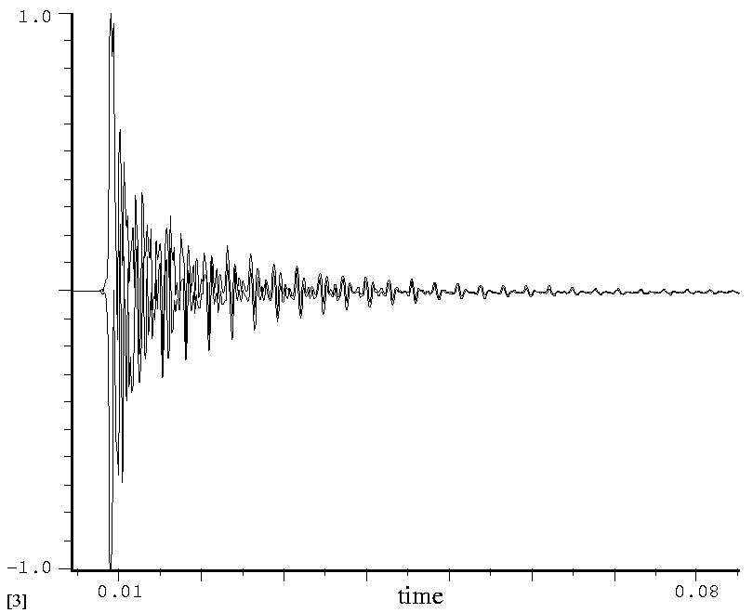
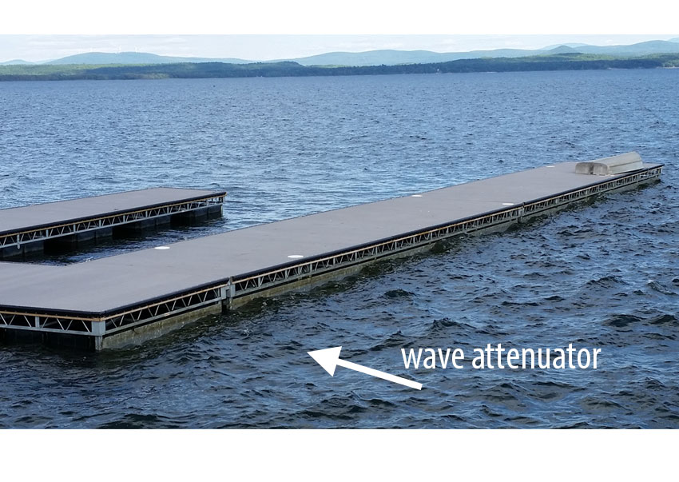
Exercise 6d: communicating at a distance
Sound can travel very quickly, however it also appears quieter when the source is farther away.
Attenuation is the gradual loss of intensity in the sound wave as it travels. This is caused by scattering and absorption of the wave as it moves along.
Both of the phenomena pose difficulty for animals that need to communicate. Many animals need to call to others to attract a mate, identify a food source, or to alert others of predators but in some cases they want to be heard by some and not by others.
For this reason, many animals can vary the frequency of a call depending on distance.
In this exercise we will look at the concept of attenuation and gain further understanding as to the methods that animals use to communicate at a distance.

Slide 29
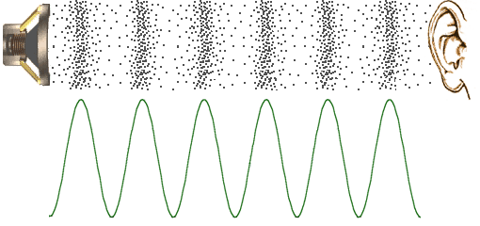
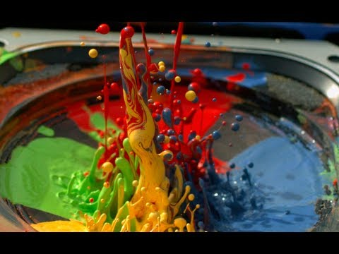
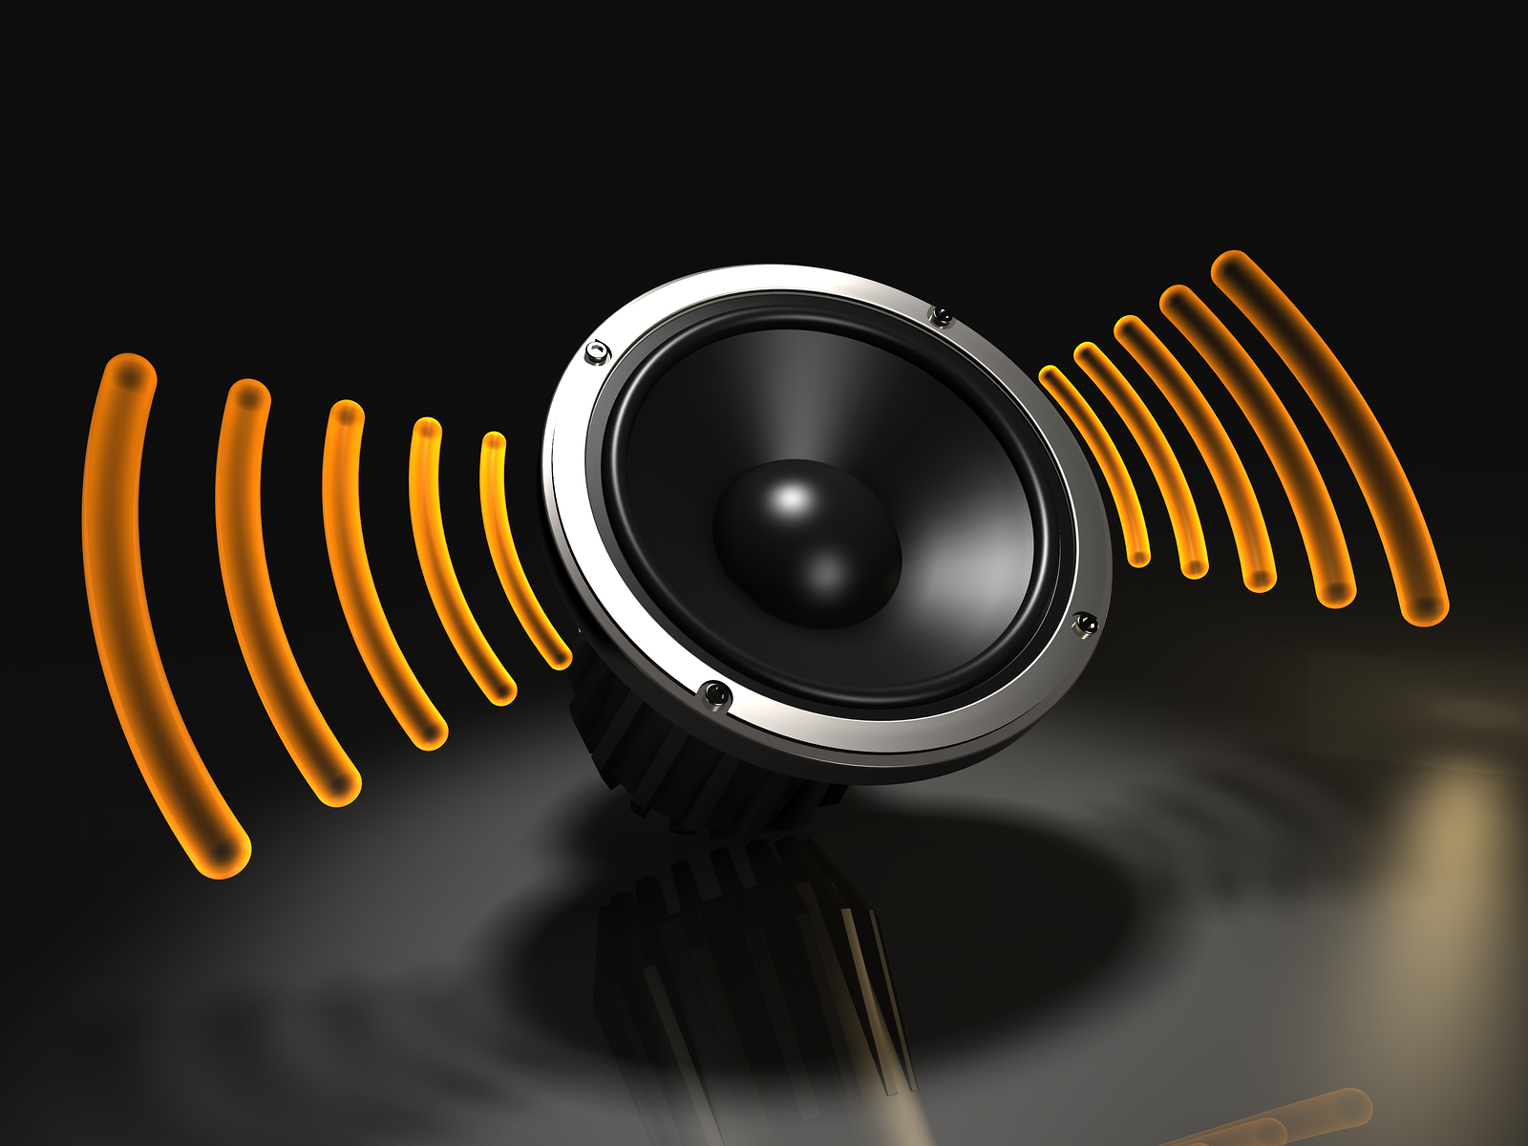
Exercise 6e: Crank it up!
The acoustics and sound industry takes advantage of the physical nature of waves. One of the main goals in this industry is to improve the distance at which sounds can be detected while maintaining high quality.
Speakers are composed of a coil wire, a magnet, a source signal input, and a diaphragm that can vibrate and they are used to transmit sounds by creating pressure waves from vibrations through the use electromagnetism.
In the following exercise we will explore the effect of the medium (speaker diaphragm) on projection and overall sound quality produced by the sound waves from a speaker.

Slide 30
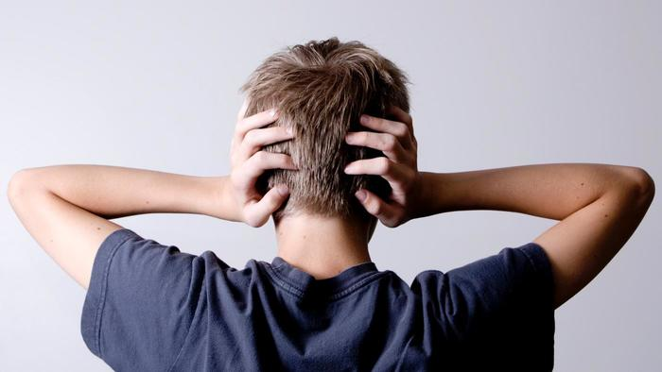
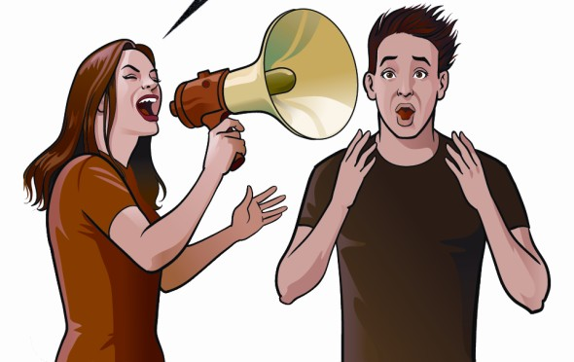

Exercise 6f: stop that noise
Animal communication and signal exchange is constrained by noise.
Nature, itself, produces a lot of sounds in the environment which collectively forms the soundscape. This jumble of sounds can often be viewed as noise as it can be quite loud in certain areas.
Noise not only occurs out in nature, but also in our cities, homes, workplaces, and schools. For this reason, soundproofing is a major industry that looks to reduce the deafening effects of noise.
In this exercise you will work with a group to design an experiment to evaluate the noise level of various sounds with and without soundproofing. You will then share you information with your class and discuss your results.

Slide 31
Refer to the workbook!
This slideshow is intended to be used a supplement to the workbook, which contains many important formulas and concepts not covered in this presentation.
Please refer to the workbook for more specific details, instructions, and procedures for the exercises mentioned in this presentation.
The answer key for all of the exercises described in this slideshow can be found in the back of the workbook.

